Slide 1
Operators in C
Md. Alamgir Hossain
Senior Lecturer,
Dept. of CSE, Prime University
Mail: alamgir.cse14.just@gmail.com

Slide 2
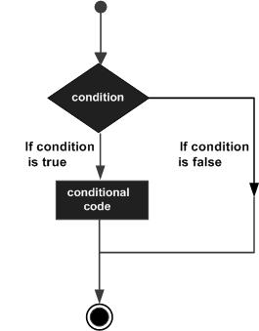

Short View on Decision Making
Decision making structures require that the programmer specifies one or more conditions to be evaluated or tested by the program, along with a statement or statements to be executed if the condition is determined to be true, and optionally, other statements to be executed if the condition is determined to be false.

Slide 3
Decision Making (if statement)
Syntax:

Slide 4
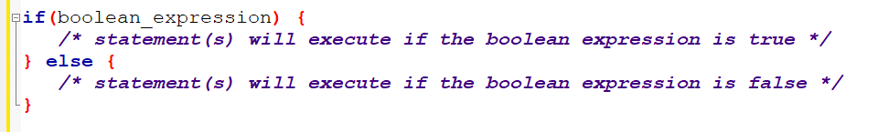
Decision Making (if...else statement)
Syntax:

Slide 5

Operators
An operator is a symbol that tells the compiler to perform specific mathematical or logical functions.
C language is rich in built-in operators and provides the following types of operators −
Arithmetic Operators
Relational Operators
Logical Operators
Bitwise Operators
Assignment Operators
Other Operators

Slide 6
Arithmetic Operators
The following table shows all the arithmetic operators supported by the C language. Assume variable A holds 10 and variable B holds 20 then −
Operator | Description | Example
+ | Adds two operands. | A + B = 30
− | Subtracts second operand from the first. | A − B = -10
* | Multiplies both operands. | A * B = 200
/ | Divides numerator by de-numerator. | B / A = 2
% | Modulus Operator and remainder of after an integer division. | B % A = 0
++ | Increment operator increases the integer value by one. | A++ = 11
-- | Decrement operator decreases the integer value by one. | A-- = 9

Slide 7
Relational Operators
Operator | Description | Example
== | Checks if the values of two operands are equal or not. If yes, then the condition becomes true. | (A == B) is not true.
!= | Checks if the values of two operands are equal or not. If the values are not equal, then the condition becomes true. | (A != B) is true.
> | Checks if the value of left operand is greater than the value of right operand. If yes, then the condition becomes true. | (A > B) is not true.
< | Checks if the value of left operand is less than the value of right operand. If yes, then the condition becomes true. | (A < B) is true.
>= | Checks if the value of left operand is greater than or equal to the value of right operand. If yes, then the condition becomes true. | (A >= B) is not true.
<= | Checks if the value of left operand is less than or equal to the value of right operand. If yes, then the condition becomes true. | (A <= B) is true.

Slide 8
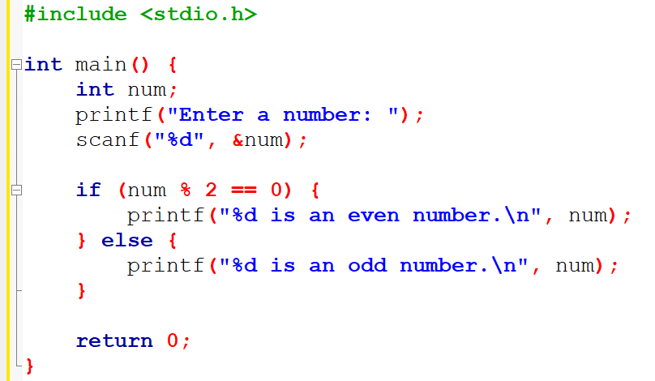
C Program to Check a Number is Even/Odd

Slide 9
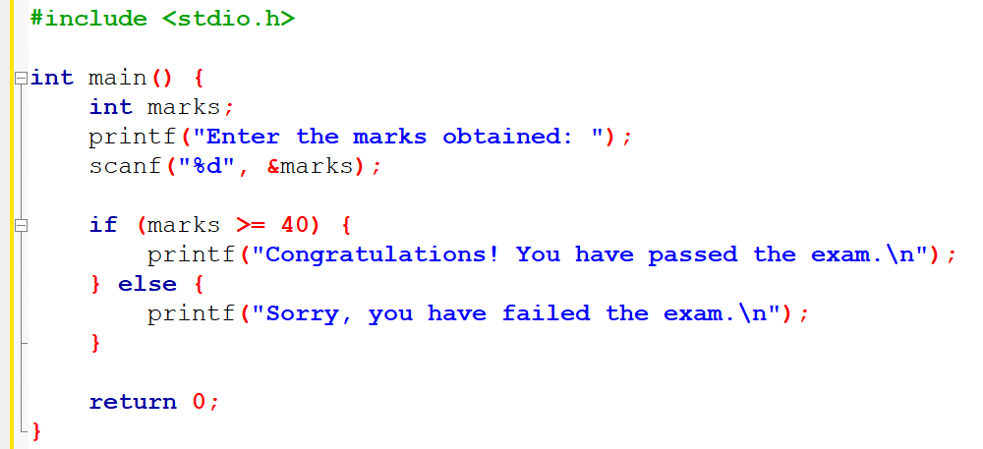
C Program to Check if a Student has Passed an Exam/Not

Slide 10
Logical Operators
Following table shows all the logical operators supported by C language. Assume variable A holds 1 and variable B holds 0, then −
Operator | Description | Example
&& | Called Logical AND operator. If both the operands are non-zero, then the condition becomes true. | (A && B) is false.
|| | Called Logical OR Operator. If any of the two operands is non-zero, then the condition becomes true. | (A || B) is true.
! | Called Logical NOT Operator. It is used to reverse the logical state of its operand. If a condition is true, then Logical NOT operator will make it false. | !(A && B) is true.

Slide 11
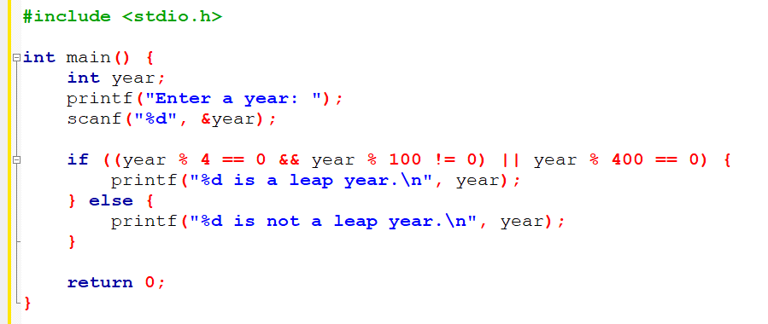
C Program to Check a Year is Leap Year/Not

Slide 12
Bitwise Operators
Bitwise operator works on bits and perform bit-by-bit operation. The truth tables for &, |, and ^ is as follows −
p | q | p & q | p | q | p ^ q
0 | 0 | 0 | 0 | 0
0 | 1 | 0 | 1 | 1
1 | 1 | 1 | 1 | 0
1 | 0 | 0 | 1 | 1

Slide 13
Bitwise Operators
Assume A = 60 and B = 13 in binary format, they will be as follows −
A = 0011 1100
B = 0000 1101
-----------------
A&B = 0000 1100
A|B = 0011 1101
A^B = 0011 0001
~A = 1100 0011

Slide 14
Bitwise Operators
Operator | Description | Example
& | Binary AND Operator copies a bit to the result if it exists in both operands. | (A & B) = 12, i.e., 0000 1100
| | Binary OR Operator copies a bit if it exists in either operand. | (A | B) = 61, i.e., 0011 1101
^ | Binary XOR Operator copies the bit if it is set in one operand but not both. | (A ^ B) = 49, i.e., 0011 0001
~ | Binary One's Complement Operator is unary and has the effect of 'flipping' bits. | (~A ) = ~(60), i.e,. -61 = 1100 0011
<< | Binary Left Shift Operator. The left operands value is moved left by the number of bits specified by the right operand. | A << 2, i.e., 5 to 20
>> | Binary Right Shift Operator. The left operands value is moved right by the number of bits specified by the right operand. | A >> 2, i.e., 54 to 13

Slide 15
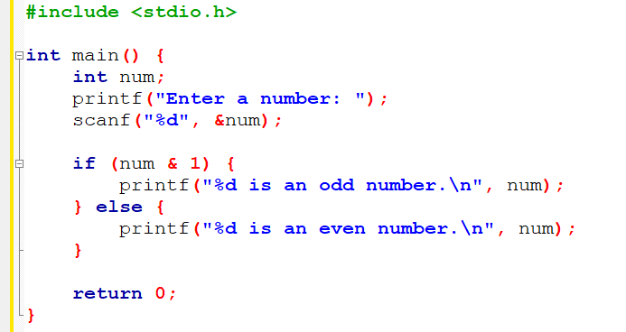
Even/Odd Check using Bitwise Operators

Slide 16
Assignment Operators
Operator | Description | Example
= | Simple assignment operator. Assigns values from right side operands to left side operand | C = A + B will assign the value of A + B to C
+= | Add AND assignment operator. It adds the right operand to the left operand and assign the result to the left operand. | C += A is equivalent to C = C + A
-= | Subtract AND assignment operator. It subtracts the right operand from the left operand and assigns the result to the left operand. | C -= A is equivalent to C = C - A
*= | Multiply AND assignment operator. It multiplies the right operand with the left operand and assigns the result to the left operand. | C *= A is equivalent to C = C * A
/= | Divide AND assignment operator. It divides the left operand with the right operand and assigns the result to the left operand. | C /= A is equivalent to C = C / A

Slide 17
Assignment Operators
Operator | Description | Example
%= | Modulus AND assignment operator. It takes modulus using two operands and assigns the result to the left operand. | C %= A is equivalent to C = C % A
<<= | Left shift AND assignment operator. | C <<= 2 is same as C = C << 2
>>= | Right shift AND assignment operator. | C >>= 2 is same as C = C >> 2
&= | Bitwise AND assignment operator. | C &= 2 is same as C = C & 2
^= | Bitwise exclusive OR and assignment operator. | C ^= 2 is same as C = C ^ 2
|= | Bitwise inclusive OR and assignment operator. | C |= 2 is same as C = C | 2

Slide 18
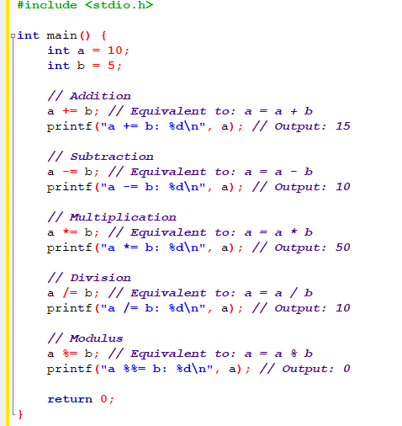
Example of Assignment Operators

Slide 19
sizeof & ternary Operators
Operator | Description | Example
sizeof() | Returns the size of a variable. | sizeof(a), where a is integer, will return 4.
& | Returns the address of a variable. | &a; returns the actual address of the variable.
* | Pointer to a variable. | *a;
? : | Conditional Expression. | If Condition is true ? then value X : otherwise value Y

Slide 20
Homework
Write a C program to determine the largest from three numbers.
Write a C program to swap two number using temporary variable, addition and subtraction, bitwise XOR, without a temporary variable.

Slide 21
Thank You

